Slide 1

Python Project S7
Spam Dataset

Slide 2
The dataset
48 continuous real attributes of word % in email
9 other data that relate to the overall number of words in mail
1 nominal value {spam, not spam}

Slide 3
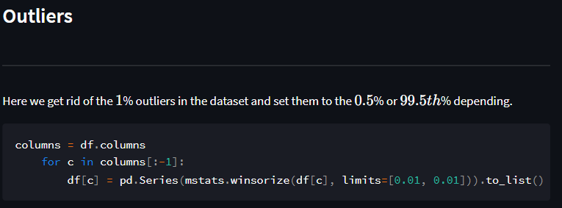

Slide 5
Data Visualization

Slide 6
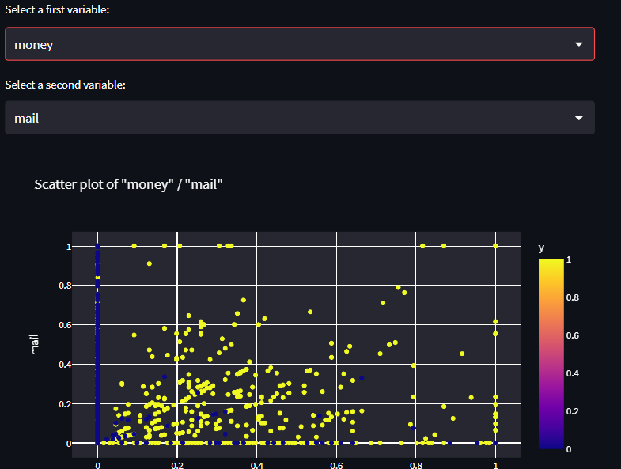

Slide 7
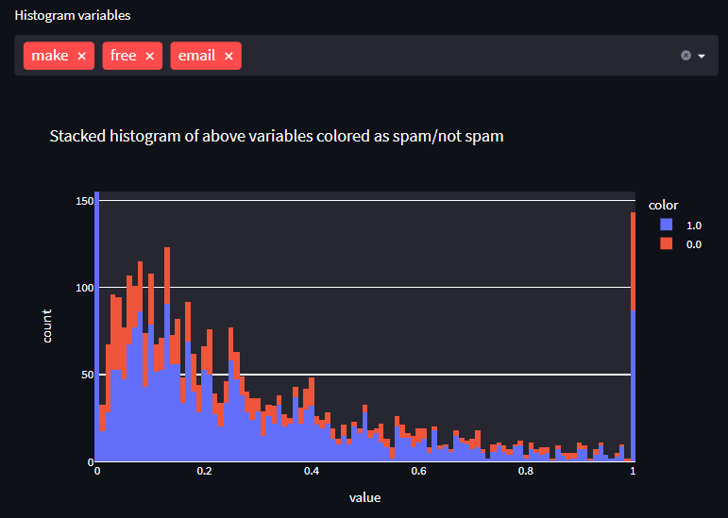

Slide 8
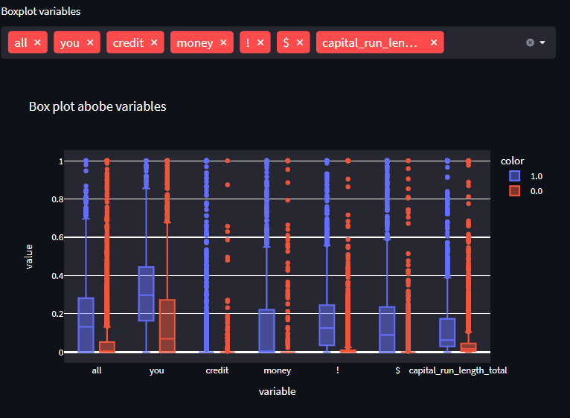

Slide 9
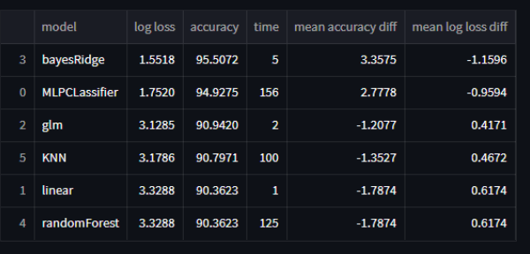
Modeling

Slide 10
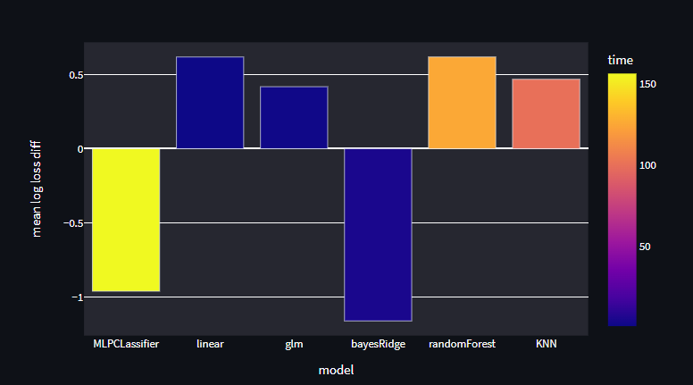
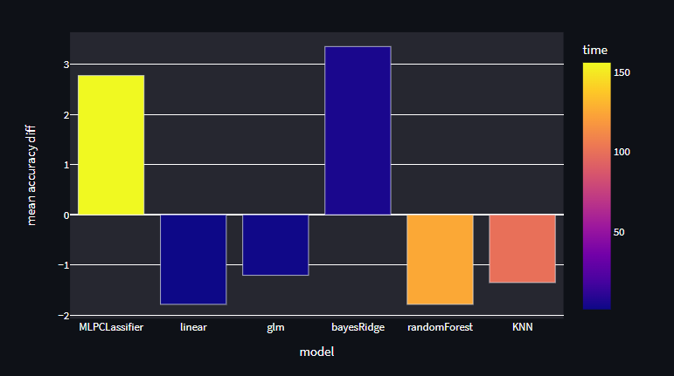

Slide 11
